Slide 1




Cook it yourself

Slide 2

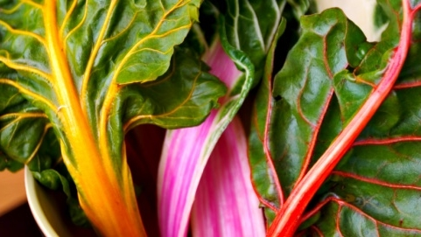

agenda
Weekly progress
Next steps
project progress

Slide 3
Weekly progress
Firebase integration
Unity knowledge sharing
Google analytics
Send it to friends/family
Logo creation

Slide 4
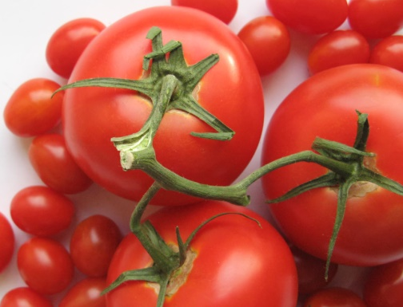
Next steps
New recipes
Live testing
Feedback implementation

Slide 5
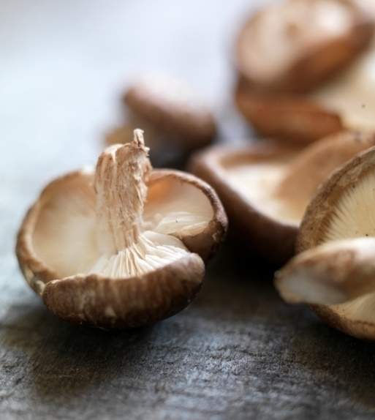
project progress

Slide 6
Thank you

